Slide 1
NFA to DFA Conversion

Slide 2
Steps for converting NFA to DFA:
Step 1: Initially Q' = ϕ
Step 2: Add q0 of NFA to Q'. Then find the transitions from this start state.
Step 3: In Q', find the possible set of states for each input symbol. If this set of states is not in Q', then add it to Q’.
Step 4: In DFA, the final state will be all the states which contain F(final states of NFA)

Slide 3
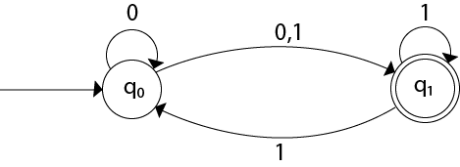
Conversion from NFA to DFA
State | 0 | 1
→q0 | {q0, q1} | {q1}
*q1 | ϕ | {q0, q1}

Slide 4
Now we will obtain δ' transition for state q0.
δ'([q0], 0) = {q0, q1}
= [q0, q1] (new state generated)
δ'([q0], 1) = {q1} = [q1]
The δ' transition for state q1 is obtained as:
δ'([q1], 0) = ϕ
δ'([q1], 1) = [q0, q1]
Now we will obtain δ' transition on [q0, q1].
δ'([q0, q1], 0) = δ(q0, 0) ∪ δ(q1, 0)
= {q0, q1} ∪ ϕ
= {q0, q1}
= [q0, q1]
Similarly,
δ'([q0, q1], 1) = δ(q0, 1) ∪ δ(q1, 1)
= {q1} ∪ {q0, q1}
= {q0, q1}
= [q0, q1]

Slide 5
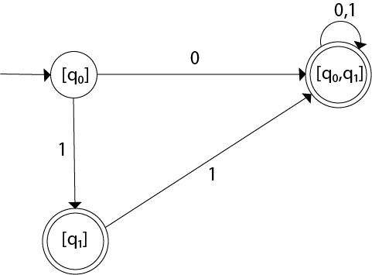
State | 0 | 1
→[q0] | [q0, q1] | [q1]
*[q1] | ϕ | [q0, q1]
*[q0, q1] | [q0, q1] | [q0, q1]

Slide 6
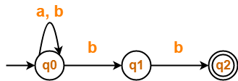
Question 1-
Convert the following Non-Deterministic Finite Automata (NFA) to Deterministic Finite Automata (DFA)-

Slide 7
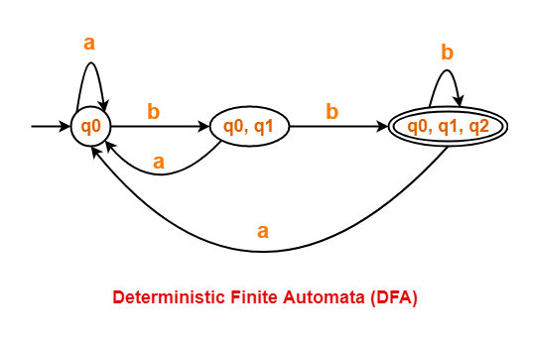
Solution 1-

Slide 8
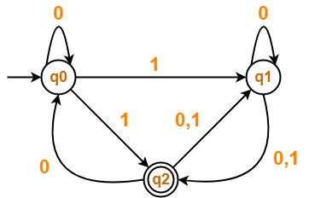
Question 2-
Convert the following Non-Deterministic Finite Automata (NFA) to Deterministic Finite Automata (DFA)-

Slide 9
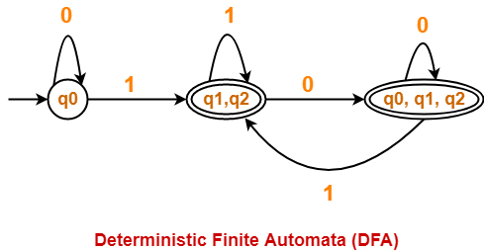
Solution 2-

Slide 10
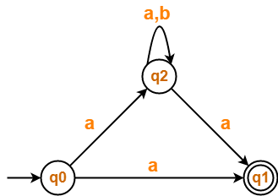
Question 3-

Slide 11
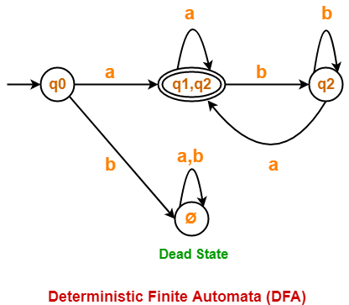
Solution 3-

Slide 12
Important Points-
After conversion, the number of states in the resulting DFA may or may not be same as NFA.
The maximum number of states that may be present in the DFA are 2^{Number of states in the NFA}.
In general, the following relationship exists between the number of states in the NFA and DFA-
1 <= n <= 2^{m}
Here,
n = Number of states in the DFA
m = Number of states in the NFA

Slide 13
4. In the resulting DFA, all those states that contain the final state(s) of NFA are treated as final states.

